Slide 1
Modelling Across Scales: From Molecules to Pandemics
Molecular Dynamics II
Dr Eleanor Jayawant
Notes:
10 mins talking, 30 mins activity, 15 mins discussion/briefing about assessment at end.

Slide 2
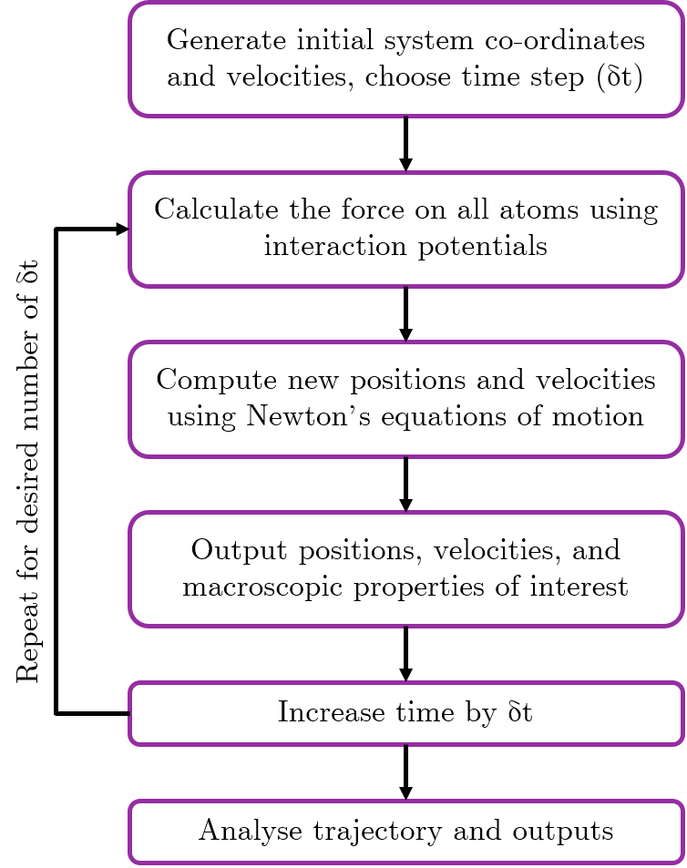
Previously on 104 SSC…
Molecular dynamics can help us understand how molecules move and interact with each other
This is very important for drug discovery
MD involves solving Newton’s equations of motion iteratively for a system, using a set of interaction potentials called a force field
Force fields have a bonded and a non-bonded component
Running an MD simulation produces a trajectory of how the atoms move, which can be visualised as a movie
Most MD simulations start with a .pdb file, which we looked at for the activity

Slide 3
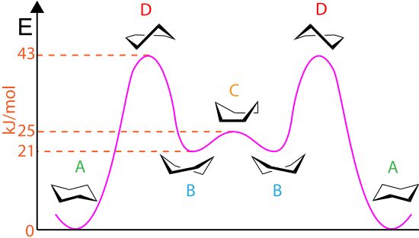
Energy landscapes are complicated!
J, Clayden (2003). Organic chemistry (2nd ed.). Oxford. p. 373.
Notes:
Even for a molecule as simple as glucose, there are multiple possible conformations. If you did A-level chemistry, you may remember learning about glucose boats and chairs, where chairs are the lowest energy state, but there is a significant energy barrier to overcome in order for a boat to become a chair. (Molymod example)

Slide 4
Energy landscapes are complicated!
even though this state has lower energy
we might get trapped in this state
Energy
Conformational State
This is called “the sampling problem”
Notes:
For a complicated system such as a protein, there may be multiple energy states that the system can be in, part of a complex energy landscape. Even rotation about a single bond can have a significant energy barrier associated with it (e.g. cis to trans peptide bond). If we don’t have the right conditions, we might get stuck with the protein being in the wrong state the whole time, because in our system it might not be possible to overcome an energy barrier associated with a conformational change.

Slide 5
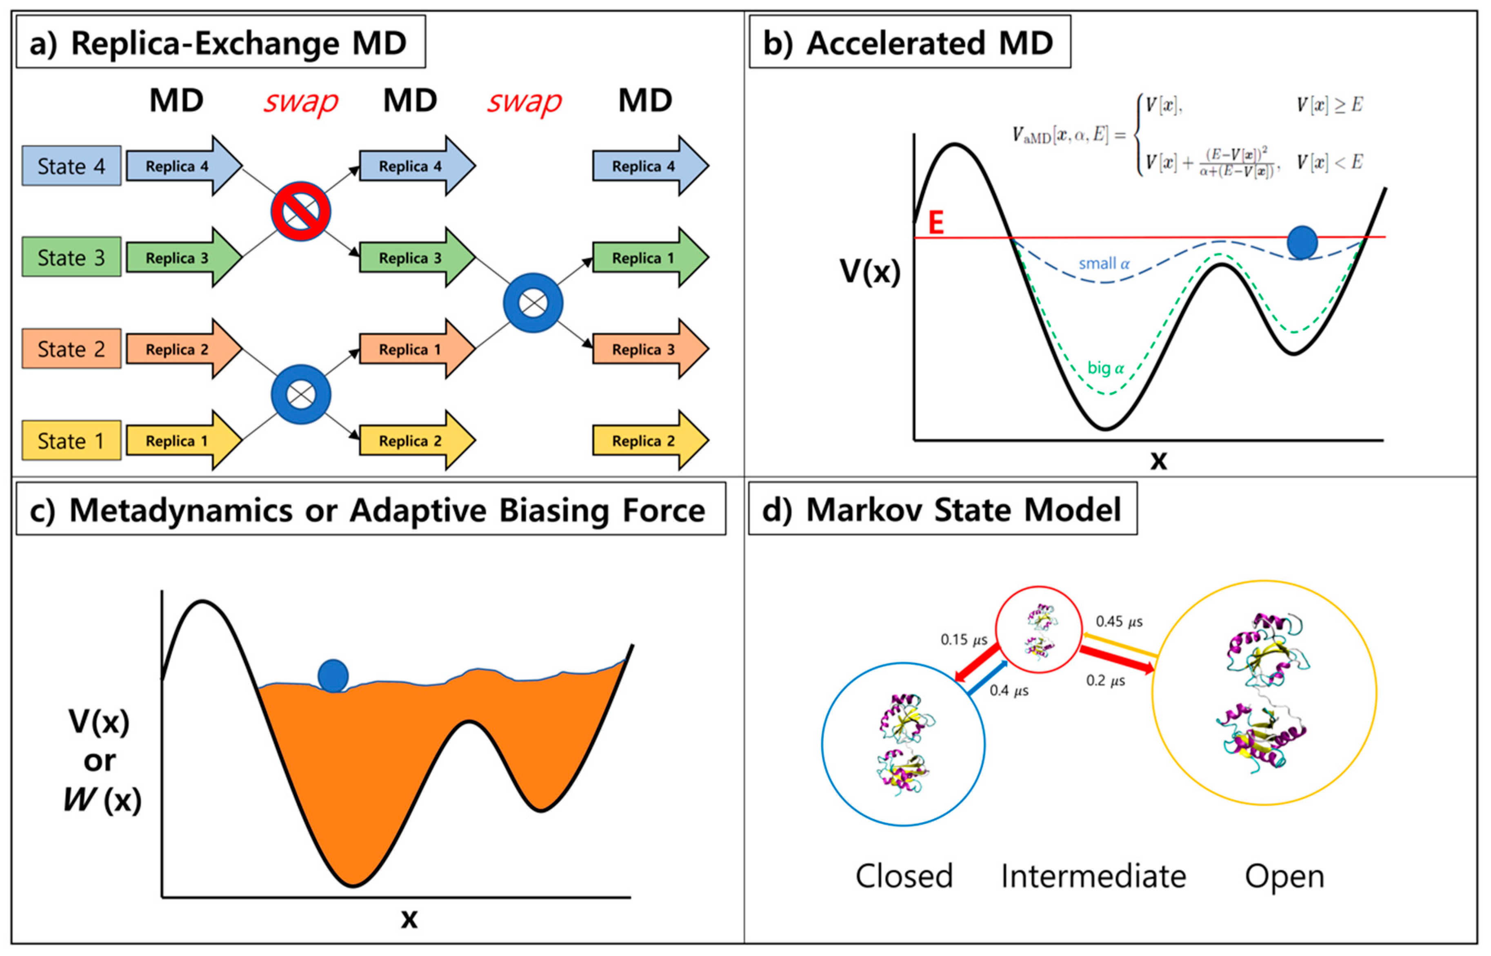
Advanced sampling techniques can help!
Lazim, R., Suh, D. and Choi, S., 2020. Advances in molecular dynamics simulations and enhanced sampling methods for the study of protein systems.
International journal of molecular sciences, 21(17), p.6339.
Notes:
I’m not going to describe these techniques, if you want to learn a bit about them then I can recommend a review article: https://www.ncbi.nlm.nih.gov/labs/pmc/articles/PMC4339458/ but for now the point I want to make it that when thinking about MD we can use extra ‘tricks’ to overcome problems in sampling, and if you read a paper on MD you might come across some of these terms.

Slide 6
Analysis of MD simulations
MD simulations can give us lots of information, including:
Secondary structure estimation
Hydrogen bonding
Angles and dihedrals
Root mean squared deviation (how the structure changes over time)
Distances between atoms/motifs
Solvent accessible surface area
Radius of gyration
Potential energies
Estimates of parameters for experimental techniques (e.g. NMR)
And more!
Notes:
We can obtain a lot of information from MD simulations, I’ll quickly run through why we care about a couple of these in a little more detail.

Slide 7
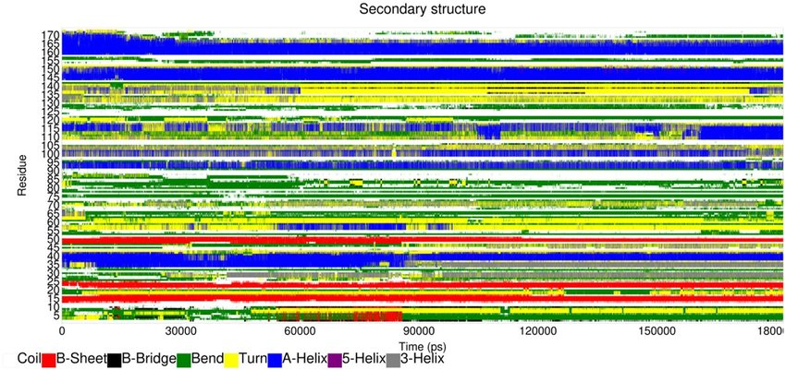
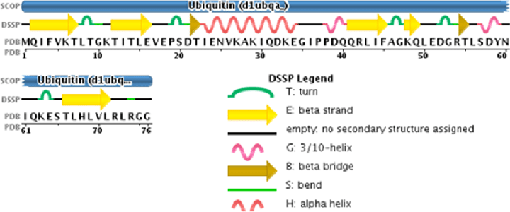
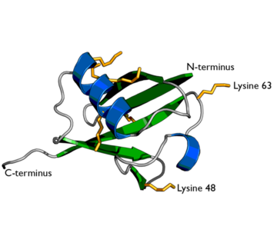
Analysis of MD simulations: secondary structure
Secondary structure is very important for overall protein structure and stability
Different types of structures are associated with different functions, e.g. alpha-helices are often found in membrane proteins and have important biological functions such as cell signalling initiator
We can predict secondary structure for each amino acid in a simulation, using algorithms such as DSSP (Define Secondary Structure of Proteins)
This allows us to easily identify regions of secondary structure, and see how it changes over the course of the simulation

Slide 8
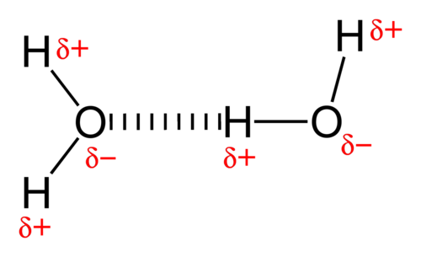
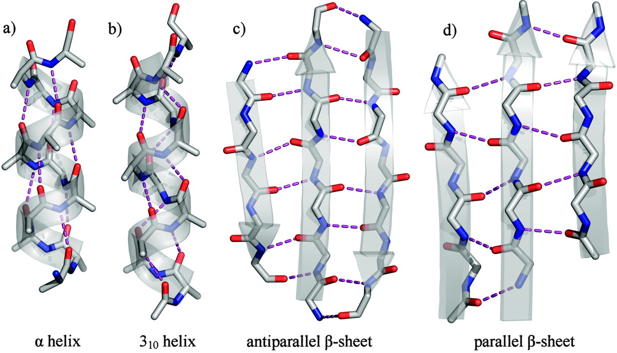
Analysis of MD simulations: hydrogen bonding
Hydrogen bonds form between a hydrogen atom (donor) bound to a more electronegative atom, and another electronegative atom (acceptor)
They play an important role in determining the three-dimensional structures and properties of proteins, and are important for stability between subunits in proteins
If we can understand the hydrogen bonding pattern of a macromolecule, we can better understand its structure, properties and function
Notes:
Hydrogen bonding is a special type of dipole-dipole attraction between molecules, not a covalent bond to a hydrogen atom. It results from the attractive force between a hydrogen atom covalently bonded to a very electronegative atom such as a N, O, or F atom and another very electronegative atom.

Slide 9
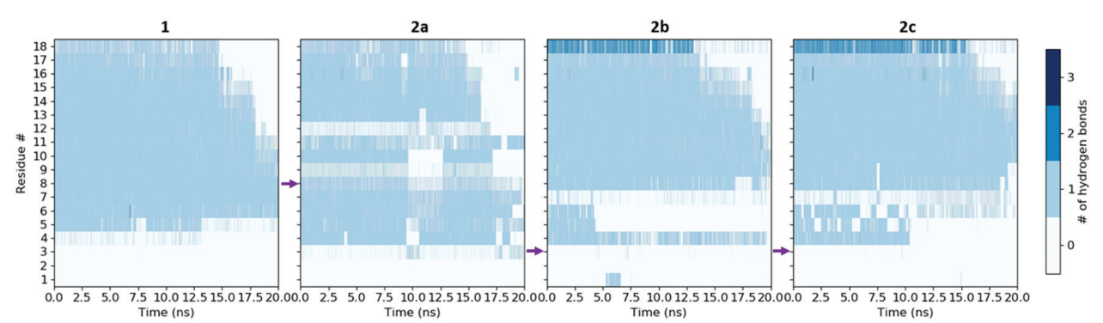
Analysis of MD simulations: hydrogen bonding
Hydrogen bonds form between a hydrogen atom (donor) bound to a more electronegative atom, and another electronegative atom (acceptor)
They play an important role in determining the three-dimensional structures and properties of proteins, and are important for stability between subunits in proteins
If we can understand the hydrogen bonding pattern of a macromolecule, we can better understand its structure, properties and function
Jayawant, E.S., Beadle, J.D., Wilkening, I., Raubo, P., Shipman, M., Notman, R. and Dixon, A.M., 2020.
Impact of oxetane incorporation on the structure and stability of alpha-helical peptides.
Physical Chemistry Chemical Physics, 22(43), pp.25075-25083.
Notes:
Hydrogen bonding is a special type of dipole-dipole attraction between molecules, not a covalent bond to a hydrogen atom. It results from the attractive force between a hydrogen atom covalently bonded to a very electronegative atom such as a N, O, or F atom and another very electronegative atom.

Slide 10
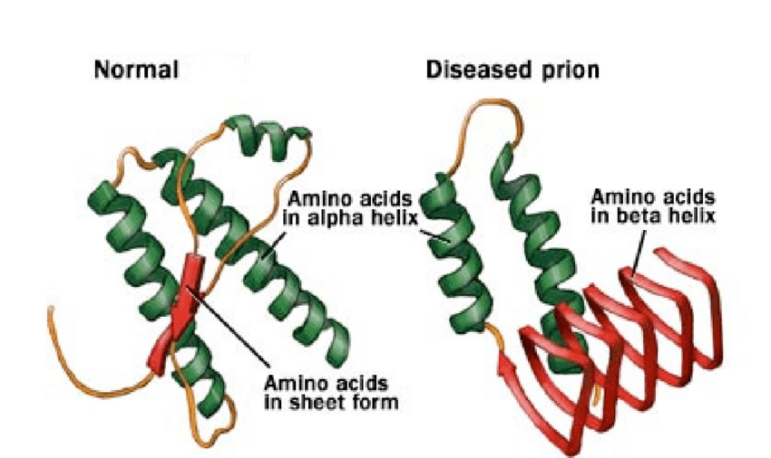
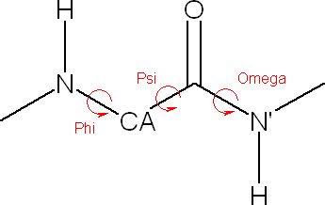
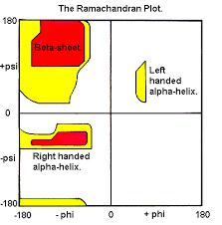
Analysis of MD simulations: angles and dihedrals
Understanding how the angles and dihedrals inside a molecule change over time gives an indication of how the molecule is moving dynamically and which areas might be more flexible/rigid
This can also give an indication of secondary structure – if we plot the phi vs. psi angles for each amino acid, we can produce a Ramachandran plot
Different secondary structure motifs have different characteristic phi/psi angles, corresponding to different regions on the plot
We’ll make a Ramachandran plot in the activity!
https://www.mayoclinic.org/diseases-conditions/creutzfeldt-jakob-disease/multimedia/normal-and-diseased-prions/img-20007478
Notes:
Use molymod to show phi and psi angles

Slide 11
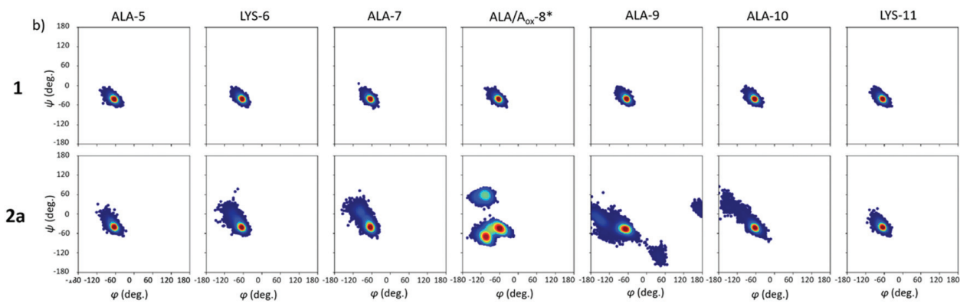
Analysis of MD simulations: angles and dihedrals
Jayawant, E.S., Beadle, J.D., Wilkening, I., Raubo, P., Shipman, M., Notman, R. and Dixon, A.M., 2020.
Impact of oxetane incorporation on the structure and stability of alpha-helical peptides.
Physical Chemistry Chemical Physics, 22(43), pp.25075-25083.
Notes:
Use molymod to show phi and psi angles

Slide 12
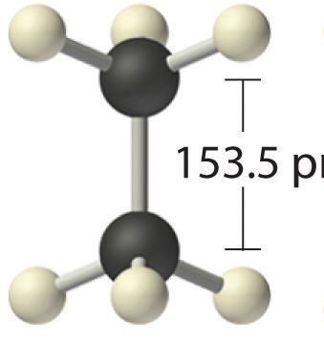
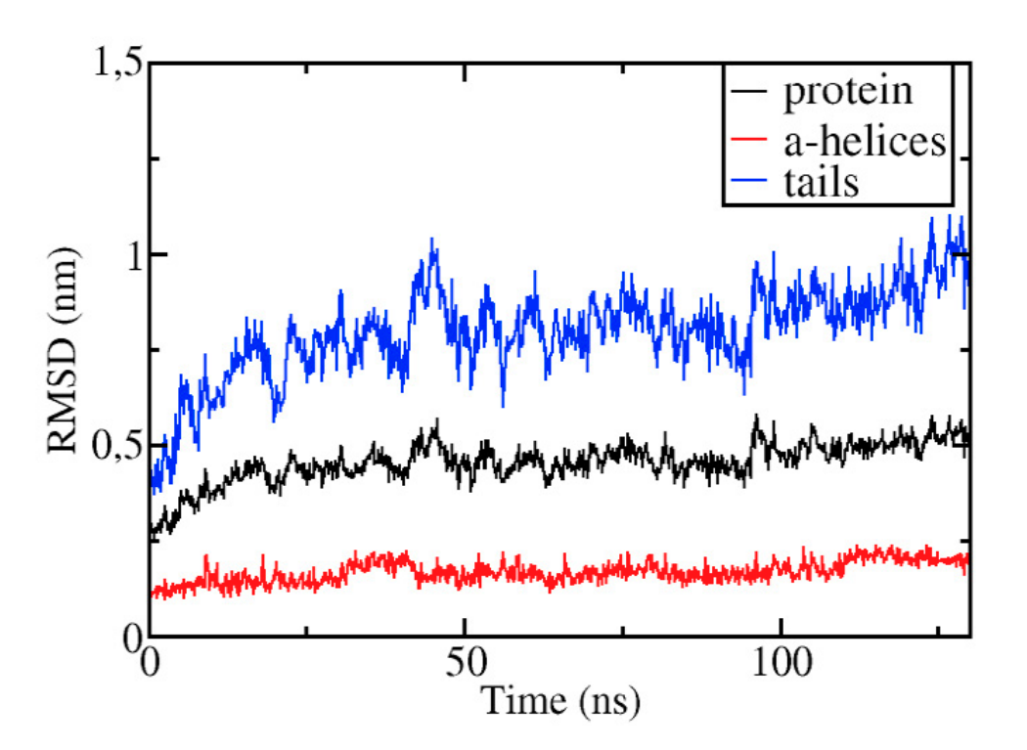
Analysis of MD simulations: RMSD
RMSD is a measure of difference between two structures
This is used as an indicator of accuracy of a model, and to ensure that a system is in equilibrium (i.e. not changing still)
The smaller the deviation, the more spatially equivalent the two structures
More flexible regions of proteins may have large deviations in RMSD, while more stable structures will change less – the overall RMSD will be an average of all residues
0.154 nm
Arnittali, M., Rissanou, A.N. and Harmandaris, V., 2019. Structure of biomolecules through molecular dynamics simulations.
Procedia Computer Science, 156, pp.69-78.

Slide 13
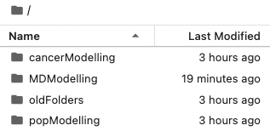
Activity
Task:
Open Jupyter Notebook (http://mitchell.science/ssc)
Click “Run” for each cell to:
Load a PDB file
Run a basic MD simulation
Perform some analysis
You do not need to write any code!
Questions to answer:
What happens to end-to-end distance?
Are there any important structures that emerge in the Ramachandran plot?
What happens if you change the temperature of the simulation? This can be a thought experiment if you don’t have time to actually run this simulation!
Last 15 mins – class discussion and briefing about assessment

Slide 14
Assessment of SSC 104

Slide 15




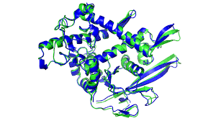
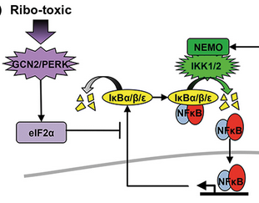
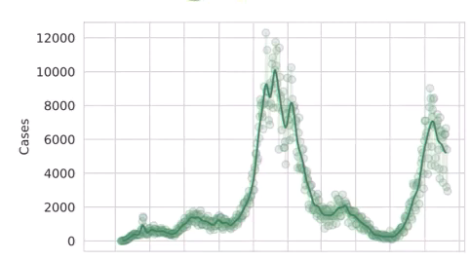
What we covered
Dr Eleanor Jayawant. Dr Richard Norris. Arran Pack. Dr Simon Mitchell.
Scale: Molecular Dynamics Signalling/Cancer Populations

Slide 16
Learning Outcomes
• Understand how computers and mathematics are used to simulate biology and how that is useful for medicine.
• Be able to run models of biological systems across a number of scales.
• Be able to present results generated from simulations, and understand the insight generated along with the limitations of modelling.

Slide 17
Assessment
7-minute presentations - present one modelling result.
Using one of the techniques we’ve shown you.
Potential slides:
A little background on the biology
What you did (method)
A result graph (or two) and how you interpret it
Some discussion of limitations of the approach
What you could do next.
Answer a question or two!

Slide 18
Assessment
7-minute presentations - present one modelling result.
Using one of the techniques we’ve shown you.
Potential slides:
A little background on the biology
What you did (method)
A result graph (or two) and how you interpret it
Some discussion of limitations of the approach
What you could do next.
Answer a question or two!
Everyone attends weeks 7 and 8 ( and asks questions):
Week 7 presentations: Hin Yip, Lealahni Woulfe, Molly Oakley, Anudi Dharmarathn, Shaiat Uddin, Benedic Phillip
Week 8 presentations: Hannah Wright, Susannah Snowdon, Fahad Saif, Alicja Imrak, Megan Crossman, Agisha Ampikaibalan

Slide 19
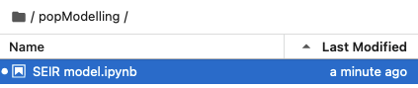
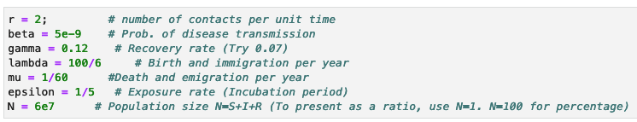
Example assessment task 1 – Population Scale
Run the SEIR (Susceptible, Exposed, Infected, Recovered) population model.
http://139.184.170.218:9001
Create a graph with the default parameters (shift enter through entire sheet).
Alter a parameter or two
Create a new graph with the new parameters, and describe the difference.
Relate the parameter change to public health measures or new viral strains.

Slide 20
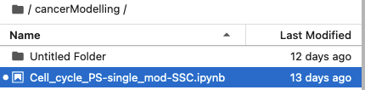
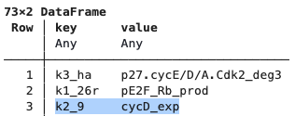
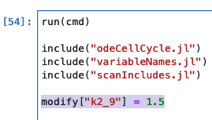
Example assessment task 2 – Cancer modelling
Run the Cell Cycle Model
http://139.184.170.218:9001
Create a graph with the default parameters (shift enter through entire sheet).
Alter a parameter to simulate a mutation.
Create a new graph with the new parameters, and describe the difference.
Relate the parameter change to mutations and what the change in cell cycle might mean for cancer.

Slide 21
Example assessment task 3 – MD
Run the MD simulation of polyalanine or polyglycine (or I’ve made some extra bonus PDB files with some of your names as the amino acid sequences)
http://mitchell.science/ssc
Create a Ramachandran plot with the default parameters (shift enter through entire sheet)
Investigate what happens if you a parameter e.g.:
The length of the simulation
The temperature
Create a new plot with the new parameters, and describe the difference
Are these results what you expected? Why/why not?

